Slide 1
CSE 5324 - SUMMER 2014
Final Presentation
Akshay Ratnaparkhi
Anand Kadia
Jyoti Salitra
Sneha Kulkarni
Wesley Mao

Slide 2

MRSK2.OVERVIEW

Slide 3
TABLE OF CONTENT
SOFTWARE DEVELOPMENT ACTIVITIES
REQUIREMENTS
PROCESS
TECHNOLOGIES
MVC ARCHITECTURE
DOMAIN DIAGRAM
CLASS DIAGRAM
USE CASE DIAGRAM
USE CASE FULL SPECIFICATION
SEQUECE DIAGRAM
DATABASE
DEMO
MRSK2.TABLE OF CONTENT

Slide 4
SOFTWARE DEVELOPMENT
ACTIVITIES
MRSK2.OVERVIEW.REQUIREMENTS

Slide 5
SOFTWARE DEVELOPMENT ACTIVITIES (AGILE)
PLANNING
DESIGNING
IMPLEMENTATION AND TESTING
DEPLOYMENT
MRSK2.SOFTWARE DEVELOPMENT ACTIVITIES

Slide 6
REQUIREMENTS
MRSK2.OVERVIEW.REQUIREMENTS

Slide 7
REQUIREMENTS
BASIC SEARCH
ADVANCE SEARCH
NAVIGATOR
PRODUCT DETAIL
CONTACT US PAGE
STORE LOCATORS
INVENTORY
MRSK2.OVERVIEW.REQUIREMENTS

Slide 8
PROCESS
MRSK2.OVERVIEW.PROCESS

Slide 9
ITERATION 1
PLANNING – REQIREMENT GATHERING
BASIC SEARCH
ITERATION 2
MVC ARCHITECTURE
NAVIGATOR
PRODUCT DETAIL
CONTACT US
STORE LOCATION
INVENTORY
FINAL PRESENTATION
ADVANCE SEARCH
CODE IMPROVEMENT
MRSK2.OVERVIEW.PROCESS

Slide 10
TECHNOLOGIES
MRSK2.OVERVIEW.TECHNOLOGIES

Slide 11
TECHNOLOGIES
TECHNOLOGIES USED FOR VIEW
BootStrap
To make it responsive on every screen.
HTML/CSS
To get stylish effects
Java Script
To make the web page more interactive.
JSP and JSTL
To make the web pages dynamic.
JSTL provides an effective way to embed logic within a JSP page without using embedded Java code directly
MRSK2.OVERVIEW.TECHNOLOGIES

Slide 12
TOOLS AND TECHNOLOGIES FOR SERVER
WebServer: Apache Tomcat
Java Platform, Enterprise Edition (J2EE)
Database: MySQL
Other libraries: mysql-j-connector, JSTL
IDE: Eclipse Kepler
JRE 7
MVC ARCHITECTURE:
Model: Java POJO (Plain Old Java Object); represents a database record in Java environment. e.g. SearchResultModel class.
View: Java Server Pages; compiled by Web Server into HTML and return to the client.
Controller: Servlets; handle request/response and control the processing among server side resources. e.g. BasicSearchServlet
MRSK2.OVERVIEW.TECHNOLOGIES

Slide 13
MVC ARCHITECTURE
MRSK2.OVERVIEW.MVC

Slide 14
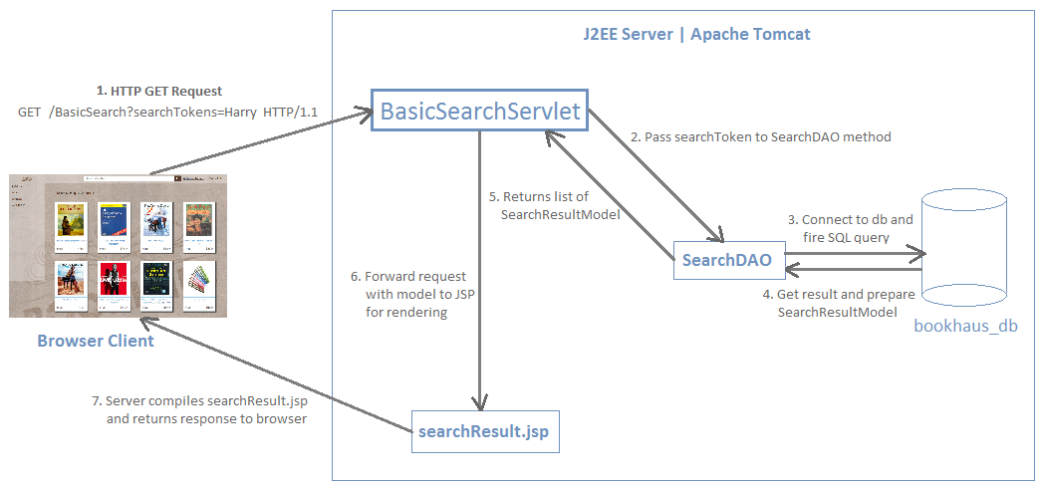
MRSK2.OVERVIEW.MVC

Slide 15
DOMAIN MODEL
MRSK2.OVERVIEW.DOMAIN DIAGRAM

Slide 16
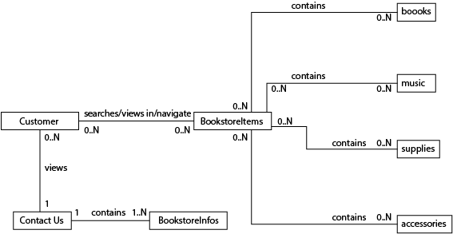
MRSK2.OVERVIEW.DOMAIN DIAGRAM

Slide 17
CLASS DIAGRAM
MRSK2.OVERVIEW.CLASS DIAGRAM

Slide 18
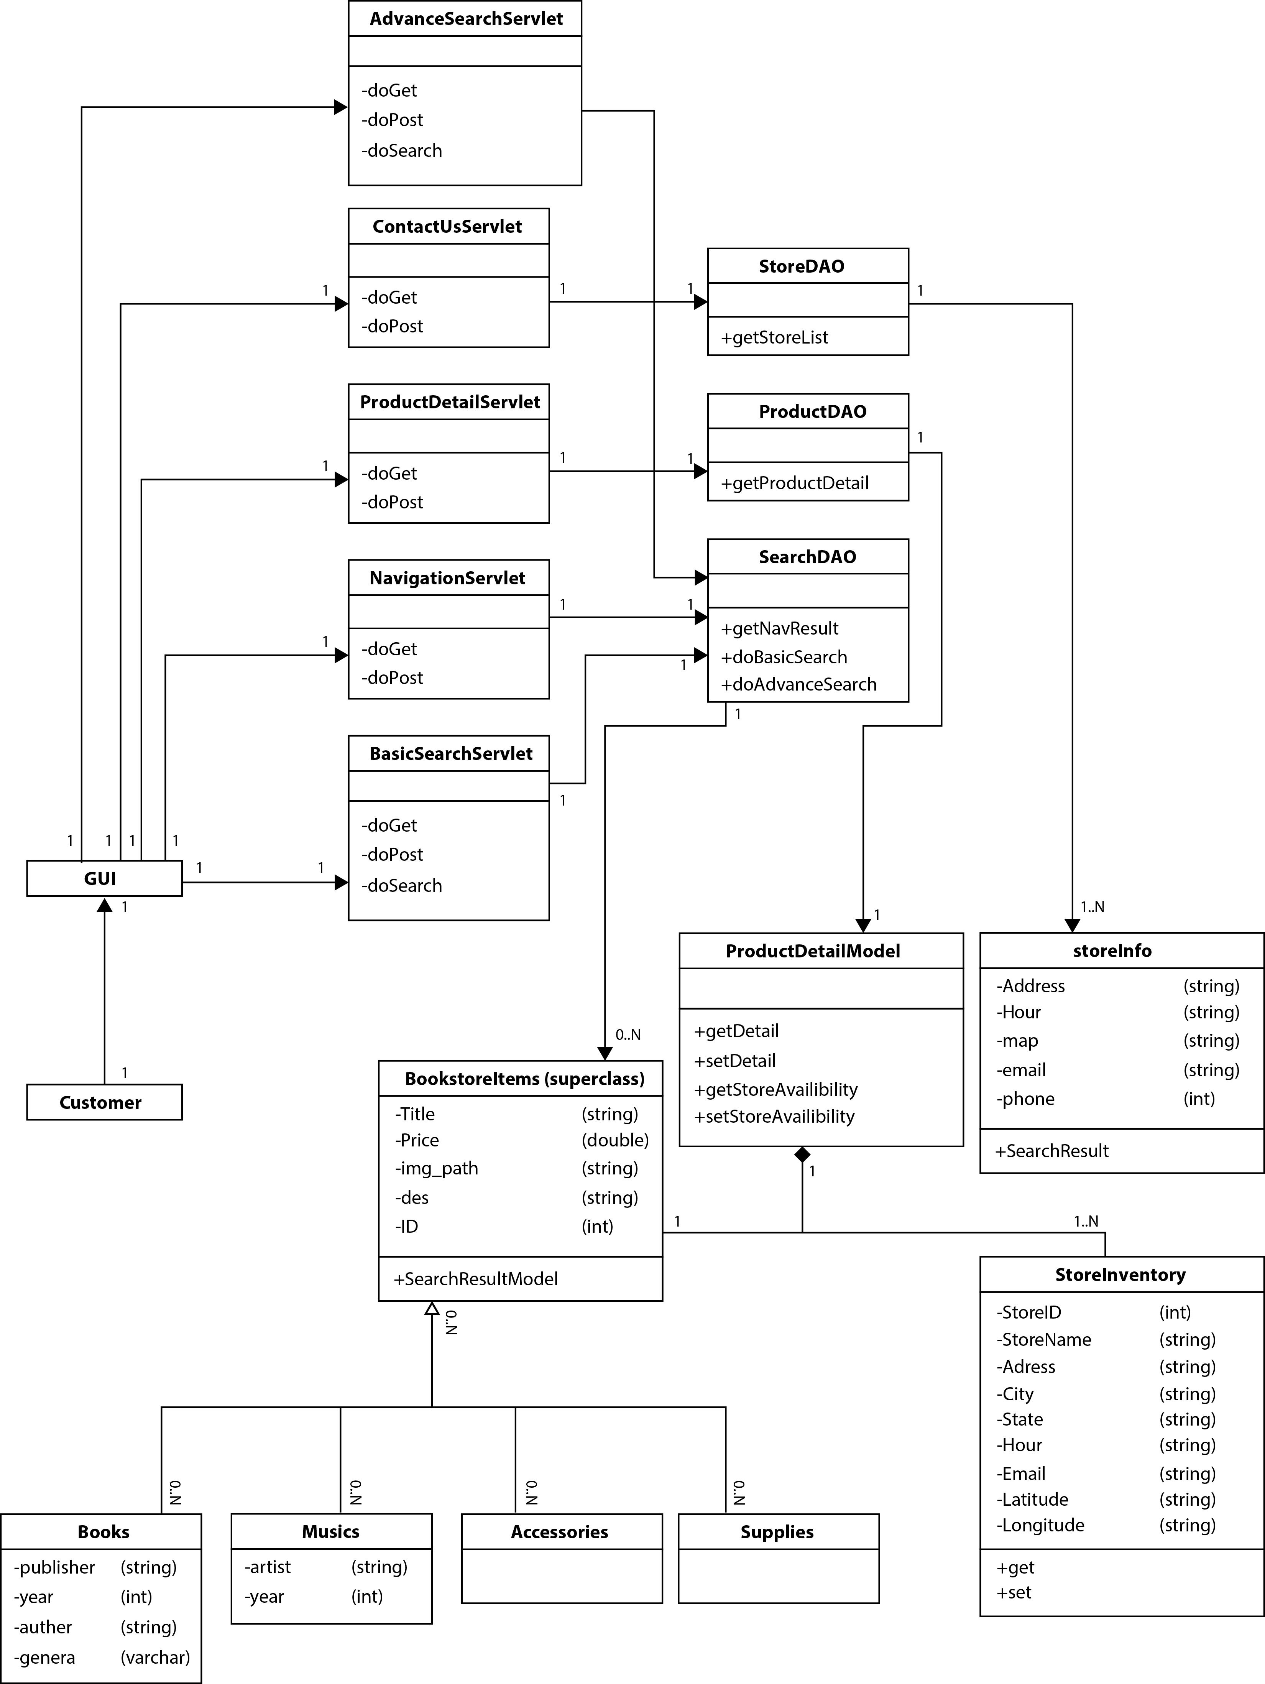
MRSK2.OVERVIEW.CLASS DIAGRAM

Slide 19
MRSK2.OVERVIEW.CLASS DIAGRAM

Slide 20
MRSK2.OVERVIEW.CLASS DIAGRAM

Slide 21
USE CASE DIAGRAM
MRSK2.OVERVIEW.USE CASE DIAGRAM

Slide 22
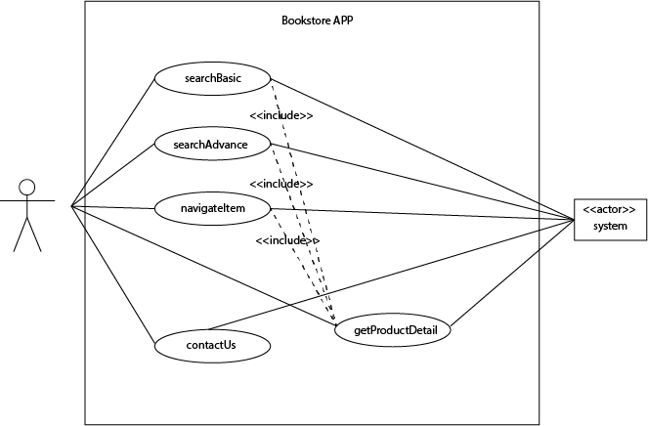
MRSK2.OVERVIEW.USE CASE DIAGRAM

Slide 23
USE CASE FULL SPECIFICATION
MRSK2.OVERVIEW.USE CASE 1

Slide 24
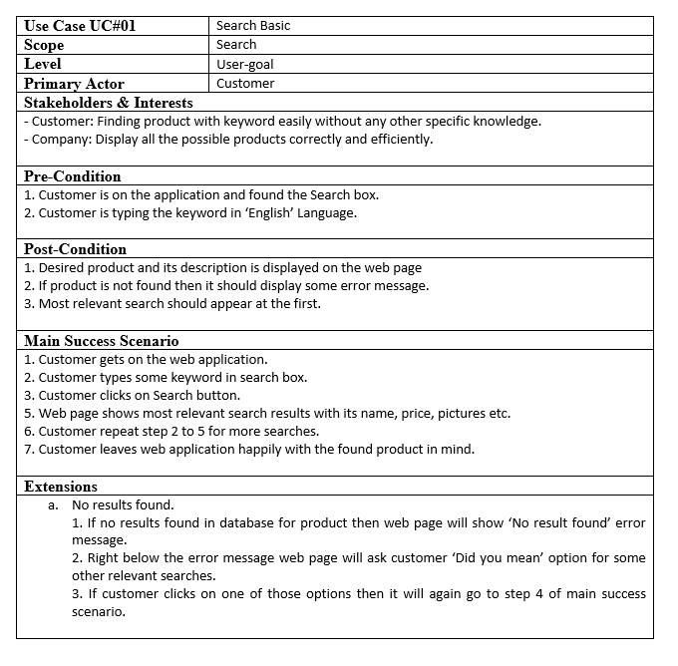
MRSK2.OVERVIEW.USE CASE 1.SEARCH BASIC.SPEC

Slide 25
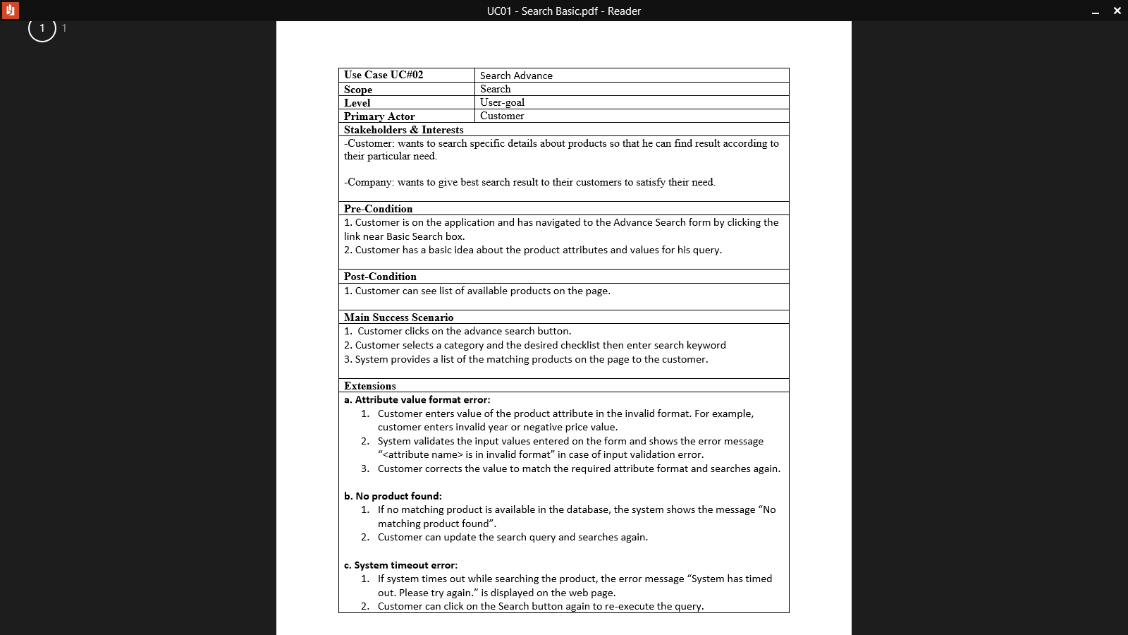
MRSK2.OVERVIEW.USE CASE 2.SEARCH ADVANCE.SPEC

Slide 26
MRSK2.OVERVIEW.USE CASE 2.SEARCH ADVANCE.SPEC

Slide 27
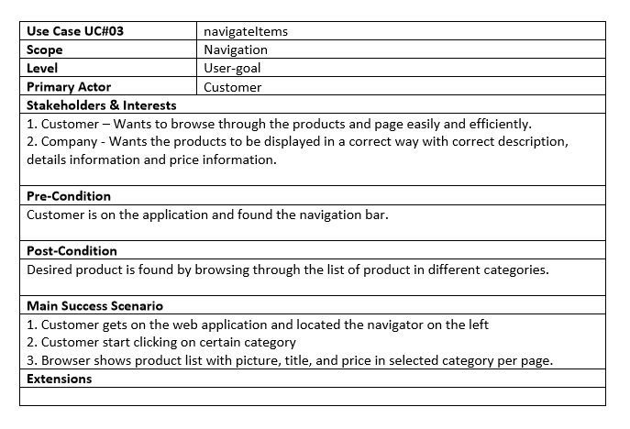
MRSK2.OVERVIEW.USE CASE 3.NAVIGATE ITEM.SPEC

Slide 28
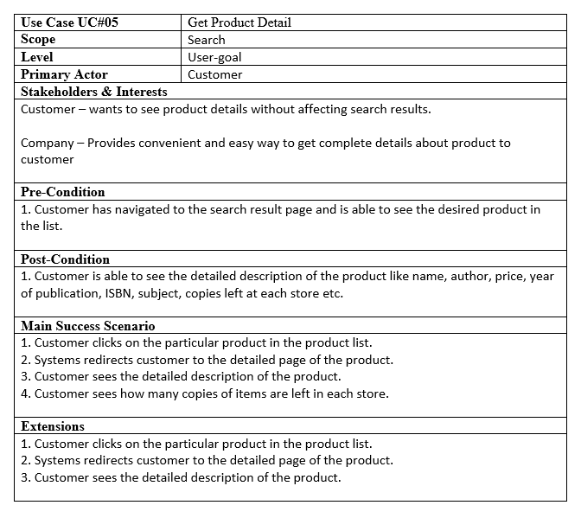
4
MRSK2.OVERVIEW.USE CASE 4.GET PRODUCT DETAIL.SPEC

Slide 29
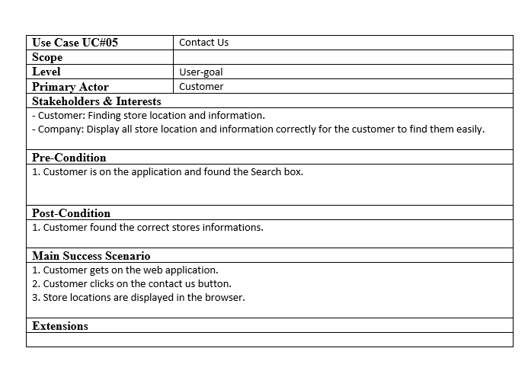
MRSK2.OVERVIEW.USE CASE 5.CONTACT US.SPEC

Slide 30
SEQUENCE DIAGRAM
MRSK2.OVERVIEW.USE CASE 2.SEQUENCE DIAGRAM

Slide 31
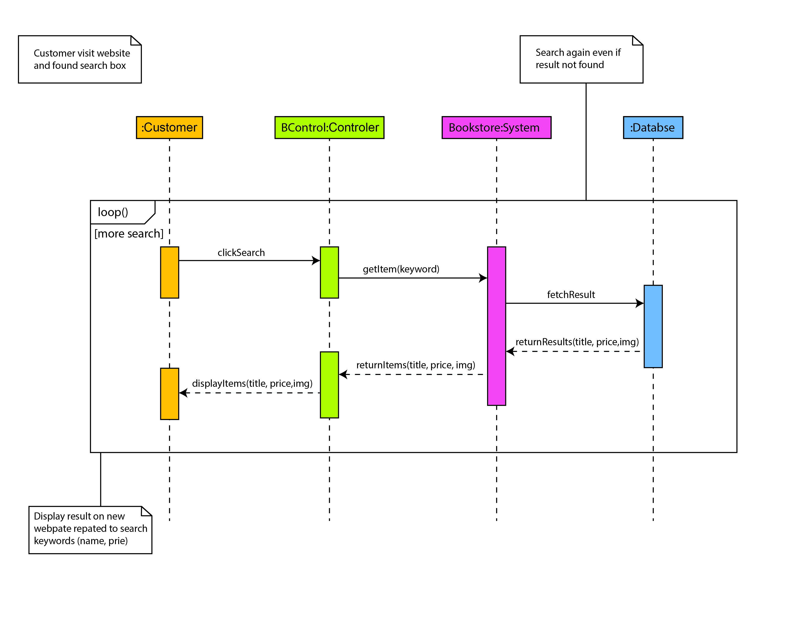
SEARCH BASIC
MRSK2.OVERVIEW.USE CASE 1.SEQUENCE DIAGRAM 01

Slide 32
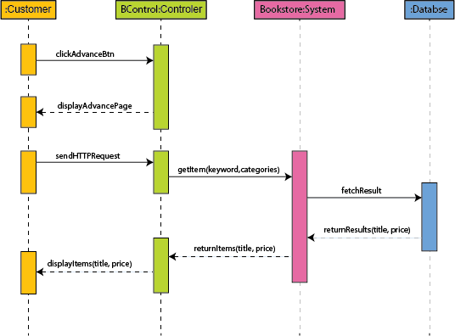
SEARCH ADVANCE
MRSK2.OVERVIEW.USE CASE 2.SEQUENCE DIAGRAM 02

Slide 33
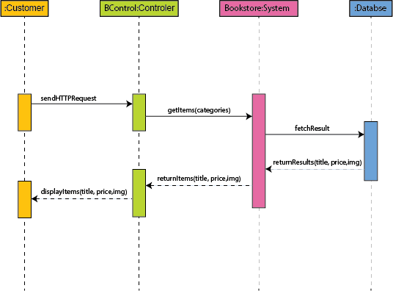
NAVIGATE
MRSK2.OVERVIEW.USE CASE 3.SEQUENCE DIAGRAM 03

Slide 34
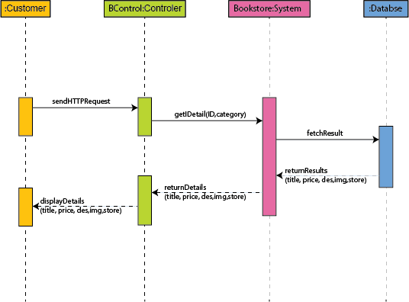
GET PRODUCT DETAIL
MRSK2.OVERVIEW.USE CASE 4.SEQUENCE DIAGRAM 04

Slide 35
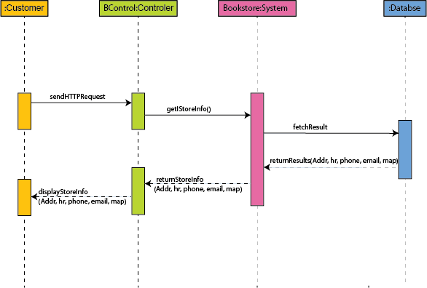
CONTACT US
MRSK2.OVERVIEW.USE CASE 5.SEQUENCE DIAGRAM 05

Slide 36
DATABASE
MRSK2.OVERVIEW.DATABASE

Slide 37
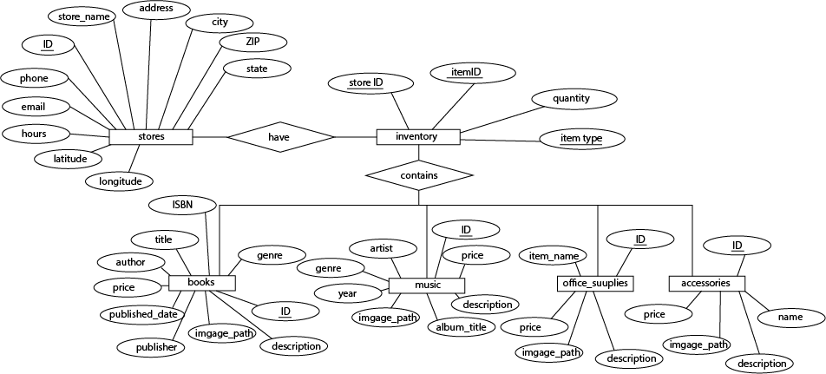
MRSK2.OVERVIEW.DATABASE

Slide 38
DEMO

